Slide 1
Virtualization
Abstraction of computer resources
Imagination of computer resources in my own computer
Refers to the creation of a virtual resources such as server, file or network
eg: we create partition of hard disk #knife

Slide 2
Benefits
We will able to use Two or more os in one pc same time
Protection :(we can use malicious file, in virtual os rather then our ….
Software testing : (in separate os .. )
Job migration : (if we have more load then I can transfer ½ load to my virtual os
Virtual storage :- partition of harddisk
Backup

Slide 3
Types of Virtualization
Desktop virtualization
Application virtualization
server virtualization
Network virtualization
Storage virtualization

Slide 4
Desktop virtualization
Desktop virtualization=. Desktop virtualization can also refer to the use of remote desktop technology to enable users to access their desktop environment from a remote location
Eg: Amazon web server (AWS),

Slide 5
Application virtualization
Application virtualization=the application packages are available on a remote server, and users can access them from their local computer without needing to install the applications locally.
When a user needs to use an application, they can simply launch it from the remote server, and the application will run in an isolated environment on the server eg:online compliier

Slide 6
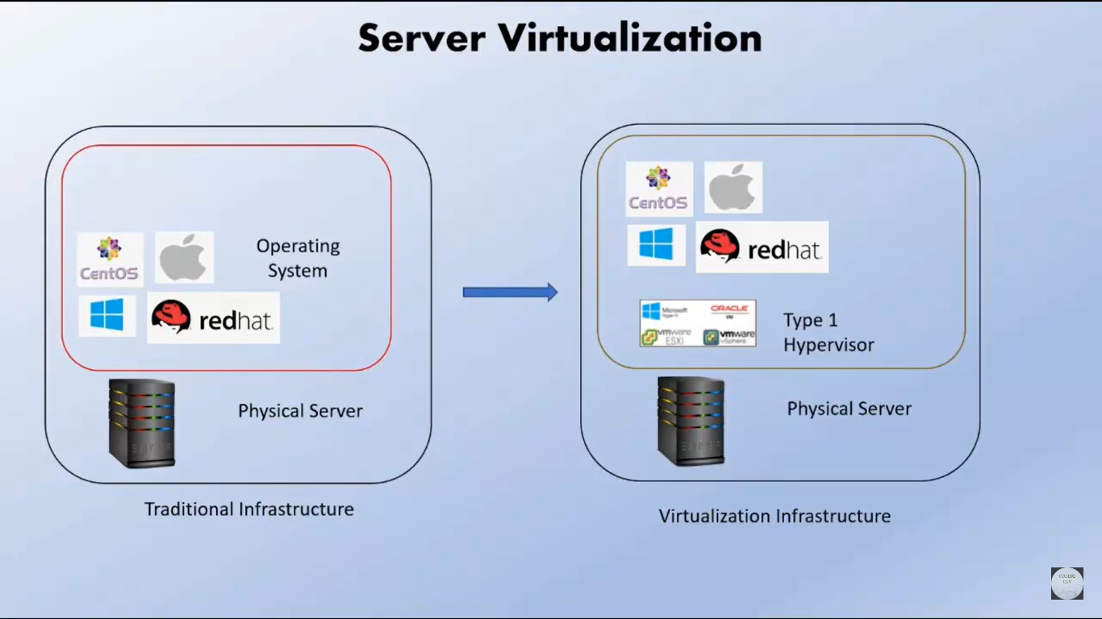
server virtualization

Slide 7
Network virtualization

